Slide 1
Drone Configurator Informal Knowledge Model
By Nelson Johnson
San Kilkis

Slide 2

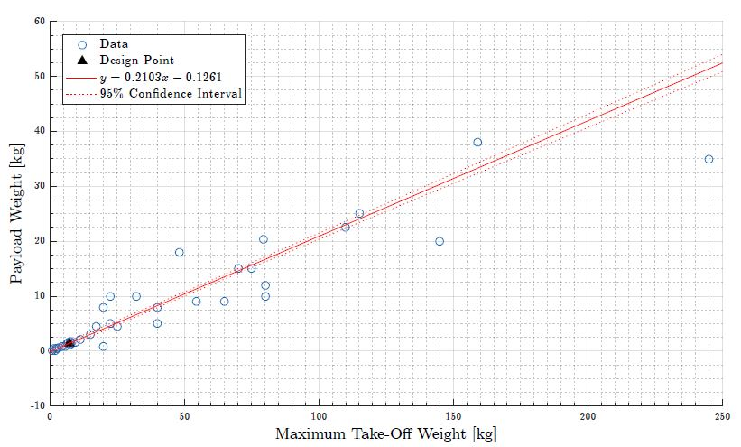
Class I Weight Estimation: (weightestimator.py)
This class estimates the MTOW from the required payload mass (or vice versa):
Reference UAV Data used is from San’s DSE group: ‘Modular UAV for Military Tasks’

Slide 3
Class II Weight Estimation: (weightestimator.py) NOT USED
This class estimates the UAV component weights:
Mass Breakdown:
W_fuse = Center, nose and tail fuselage sections (part of structural mass)
W_wings = Main wing + VT + HT masses (part of structural mass)
W_prop = Motor
W_batt = Battery
W_elec = Speed Controller(s) + Flight Computer

Slide 4

Class II Weight Estimation Cont’d (weightestimator.py) NOT USED
To comply with the MTOW requirement from class I, the allowed structural mass is found below, and split between the remaining components, (fuse and wings).
This structural mass is then split 30% to Fuselage and 70% to the wings.
Of the wings mass, the amount split between the VT, HT and main wing are a function of their areas. Each mass is found by multiplying respective area with:

Slide 5
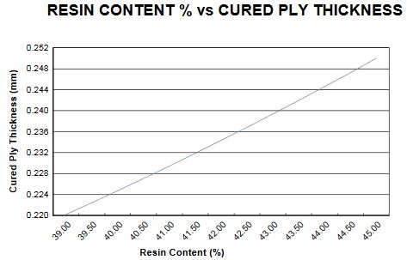
Component Weight Estimation
To estimate the component weights, we that assume they are made from a number of carbon-fiber pre-preg sheets. We multiply the number of plys with the ply thickness, number of plys and surface area. This must be done after component instantiation.
The number of plys varies per component.
http://www.ijera.com/papers/Vol4_issue5/Version%202/J45025355.pdf
The density and thickness of the sheets were found from:
http://www.abic.se/pdf/HexPlyM10-42200T2-CHS-3K.PDF

Slide 6
Wing and Power Loading: (wingpowerloading.py)
This class constructs a Wing and Thrust loading diagram and outputs a design point with assumed: C_Lmax, AR, e, density, CD0, stall speed, climb rate and gradient. This method is from the BSc. AE1222-II Course ADSEE I.
To size Wing Area:
Assumed Stall Speed & C_Lmax

Slide 7
Wing and Power Loading: (wingpowerloading.py)
To size Power, the rate of climb and climb gradient equations were used.
Requires assumed values for
Propeller efficiency, Oswald Efficiency, C_D0, rate of climb and climb gradient.
Climb Rate = c, y = W/P, S = W/S

Slide 8
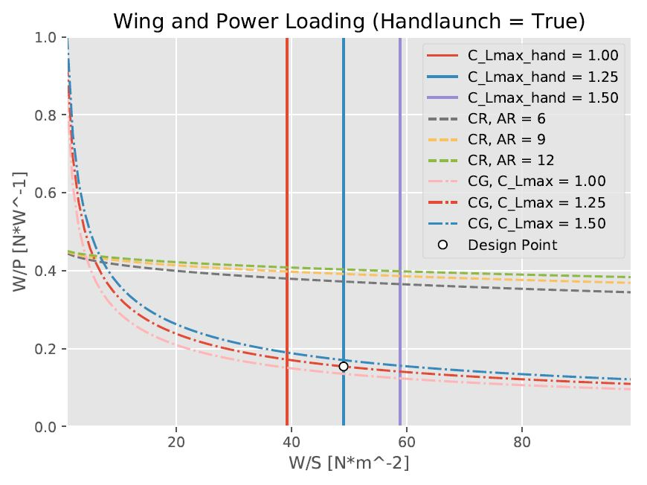
Wing and Power Loading Cont’d (wingpowerloading.py)
Climb Gradient = G, y = W/P, x = W/S
Output:
Wing Loading -> S
Power Loading -> P
For chosen design

Slide 9
Wing, VT and HT Shape: (liftingsurface.py)
This class makes a wing section with inputs:
Wing Area (S), Aspect (AR) & Taper (λ) ratios, dihedral (Γ) and twist (φ) angles. The airfoil must also be specified.
See parameterization on next slide.
These equations are from AE2111-II BSc. ADSEE II Course Wing Design Lecture II.

Slide 10
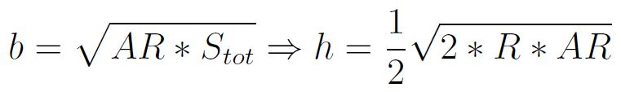
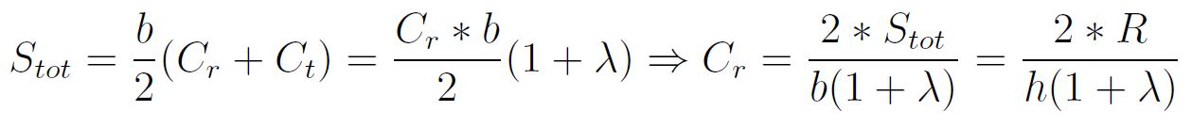


Wing Parameterization (A = AR)
h = Semipan
R = S_tot/2
The approximate position of the aerodynamic center for subsonic aircraft is at 0.25MAC
Span wise position of MAC:
Flow Direction position of MAC:
MAC
Z Direction position of MAC:

Slide 11
Wing, VT and HT Shape: (liftingsurface.py) Cont’d
Note that the MAC length was found with ParaPy, by slicing the wing at the correct spanwise location and measuring the bbox.
We assume that the wing aerodynamic center is at 0.25*MAC.
The airfoil database (collection of .dat files) used is from San’s DSE group for Low Reynold number high lift. There are 7 cambered, 2 reflexed and 2 symmetric foils with the ability to expand.
Also, we create a spar line from and to the ParaPy center of gravities of the root and tip airfoils for the boom connection point.

Slide 12
Wing (wing.py)
This class instantiates lifting surface with the inputs from class I and other assumed inputs (taper, dihedral, etc.)
It creates a bounding box for the part of the wing to be within the fuselage (for fuselage frames)
It performs an AVL analysis (AVLWrapper) to obtain the wing pitching moment and lift slope, used for the tail sizing.
The Pitching moment and lift coefficients from AVL are plotted vs. angle of attack

Slide 13

HT Sizing (scissorplot.py)
This class determines the required tail surface area with the current UAV data as input. We are neglecting the effect of the fuselage on the pitching moment. This method follows from the AE3211-I ADSEE III BSc. course.
It uses the AVL calculations for the wing pitching moment about the AC (C_mac), and the wing lift curve slope (C_Lalpha).
The HT lift curve slope is estimated with the Equation:
(a_0 = 2*pi)

Slide 14

HT Sizing Cont’d (scissorplot.py)
= -1 full moving tail
= -0.35A_{h}^{1/3} fixed tail
Sh for Stability:
Sh for Controllability:
= 0.85 for fuselage-mounted stabilizer
= 1 for T-tail and canard

Slide 15
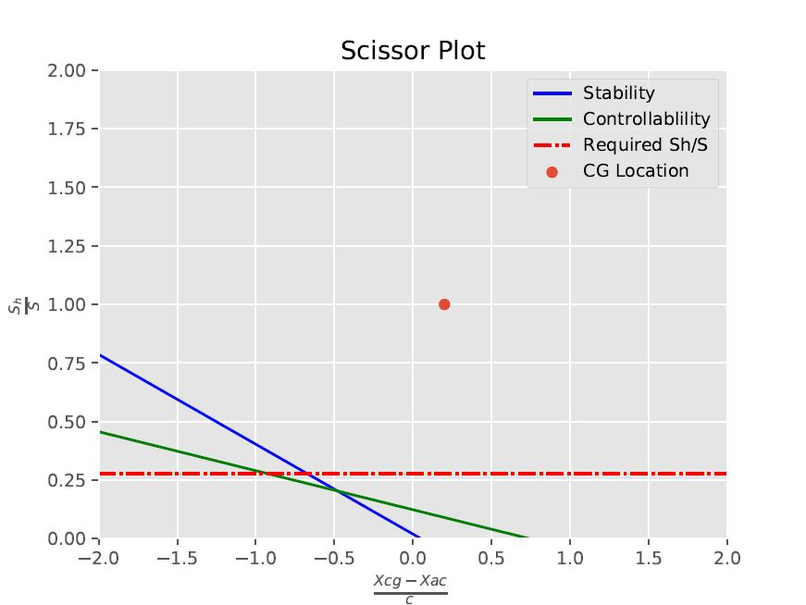
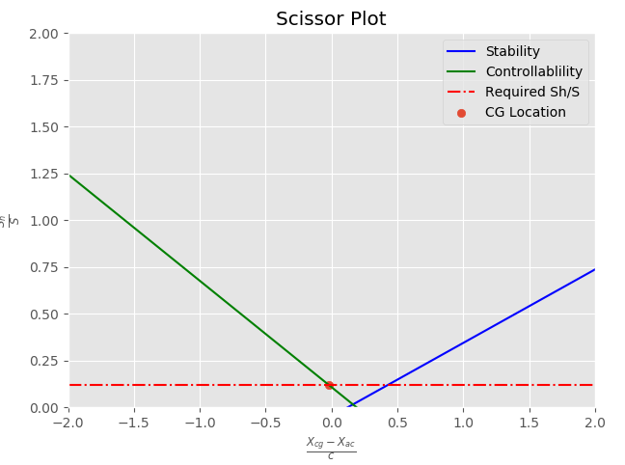
HT Sizing Cont’d (Canard Not Used) (scissorplot.py)
C_Lh > 0 and lh < 0 for canard in controllability case.
Output = Sh

Slide 16
HT Instantiation (horizontalstab.py)
This class inherits from lifting surface and overwrites the inputs corresponding to the HT. The tail surface area is derived from the scissor plot script and other assumed tailplane inputs (taper, dihedral, etc.) are prescribed.
The taper and dihedral for the HT with the current Boom Tail configuration are 1 and 0, respectively. The AR_h =5.0 was reasonably assumed with respect to ‘agricultural’ aircraft in the ‘horizontal tailplane data’ from AE3211 course.
It also creates a bounding box for the part of the HT to be within the fuselage (for fuselage frames). Currently, the fuselage doesn’t encapsulate the HT, but booms connect it to the main wing.
The HT and VT are instantiated in the compoundstabilizer.py script in the boom tail configuration.
When the compound stabilizer is instantiated at runtime, its CG is not yet taken into account, thus the cg from the weight estimation and the tail size are written to converge in a loop.

Slide 17

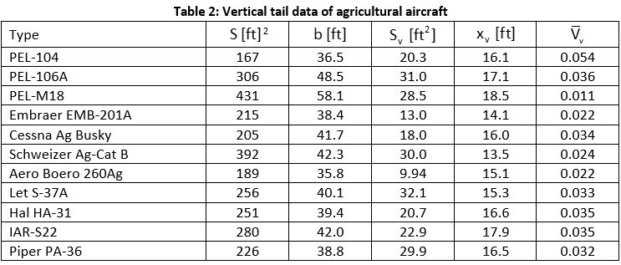
VT Sizing (verticalstab.py)
To size the VT, we estimate the tail volume coefficient as the average of that for ‘agricultural’ aircraft from the ‘vertical tailplane data’ from AE3211 course. Thus, the required VT surface area is found with a given VT arm (l_vc).
The other inputs (λ_h = 0.35, AR_h =1.4) were reasonably assumed with respect to ‘agricultural’ aircraft in the ‘vertical tailplane data’ from AE3211 course.
V_v,avg =0.0307

Slide 18
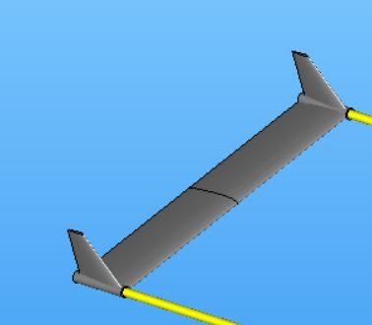
Booms (boom.py)
This class creates the booms to connect the compound stabilizer to the main wing’s spar plane.
This construction was adopted due to it’s popularity among the drone’s currently on the market
Decreases wetted surface area (les drag)
Better serviceability and portability
The Adopted style is shown below

Slide 19
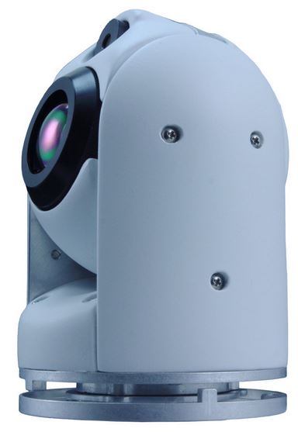
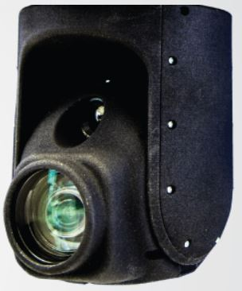
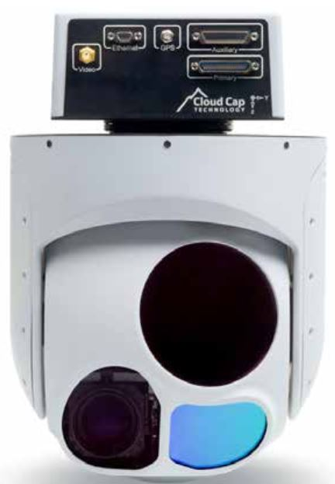
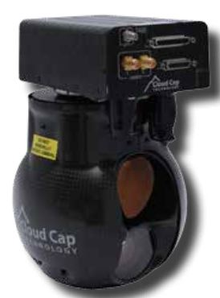
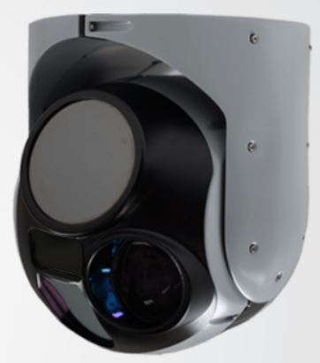
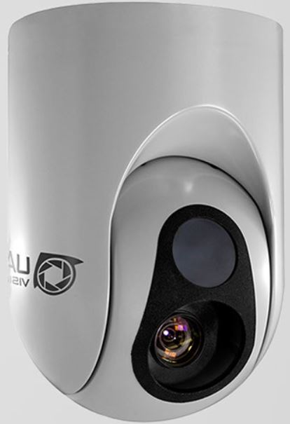
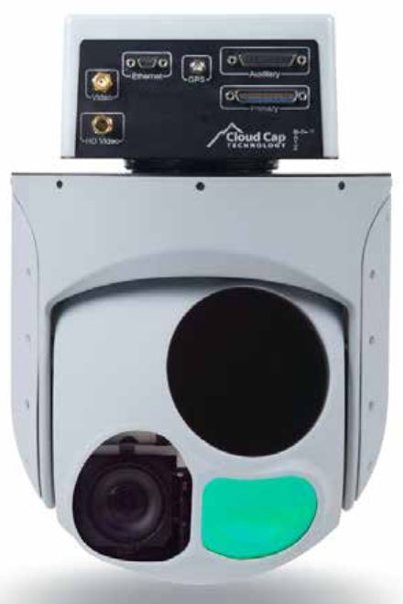
EOIR Payloads (eoir.py)
SPI-M2D
The payloads are Electro-Optical Infra-Red cameras and their dimensions and masses have been found from a few sources listed below. There are 7 cameras in the database.
SPI-M2D Camera, 0.16 kg : https://www.x20.org/m2-d-stabilized-eo-ir-flir-uav-flir-thermal-camera-gimbal/
CM100, 0.8 kg: https://uavvision.com/product/cm100/
TASE200, 1.06 kg: http://www.cloudcaptech.com/images/uploads/documents/TASE150_and_200_Data_Sheet.pdf
CM160, 1.495 kg: http://www.ascentvision.com/cm160-gimbal.html
TASE350, 3.2 kg: http://www.cloudcaptech.com/images/uploads/documents/TASE350_Data_Sheet.pdf
CM202A, 3.5 kg: https://uavvision.com/product/cm202/
TASE400LRS, 4.04 kg: http://www.cloudcaptech.com/images/uploads/documents/TASE400LRS_Data_Sheet.pdf
CM100
TASE350
TASE200
CM202A
CM160
TASE400 LRS

Slide 20
Electronics (electronics.py), (flightcontroller.py), (speedcontroller.py)
The electronics.py script instantiates the flight and speed controllers and determines their combined CG and weight
Flightcontroller (flightcontroller.py)
The flight controller is fixed and is assumed to be the Navio 2. The dimensions and mass was found here: https://emlid.com/navio/
The mass is 0.023 kg.
The dimensions are 0.065 x 0.055 x 0.017 meters (length x width x height).

Slide 21
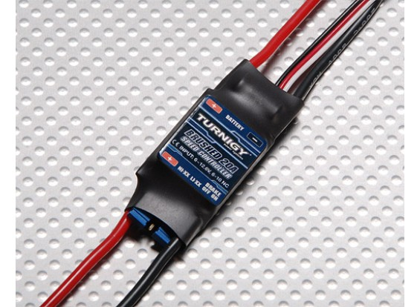
SpeedController (speedcontroller.py)
The electric speed controller (ESC) controls the current between the battery and electric motor(s).
Since our motor size (and amperage) changes with the wing size (drag) and range/endurance requirements, our ESC must change accordingly.
7 speed controllers were found on https://hobbyking.com/ and their corresponding Amp rating, weight and volume recorded. The ESC’s Amp ratings are between 6 and 120 A, corresponding to the minimum and maximum ESC recommendations in our motor database.
With this data, we performed a regression which can estimate the ESC size and mass based on the required Amp draw from the motor choice.
Also, if more than one motor is instantiated, the number of ESC’s and their combined weight increases accordingly.
We place them on top of the flight controller.

Slide 22
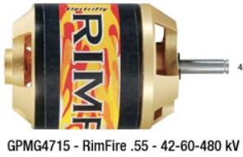
Motor (motor.py)
We have 18 motors in our database found in the link below: https://www.greatplanes.com/motors/gpmg4505.php
.csv files have been made with their relevant information such as diameter, length, constant power, shaft diameter, ESC recommendation and propeller recommendation.
The required power is found from the required Power Loading (climb gradient requirement). This power is then multiplied by the propeller efficiency to obtain the required motor power.
This is then matched to the nearest motor’s constant power rating to choose the motor.

Slide 23

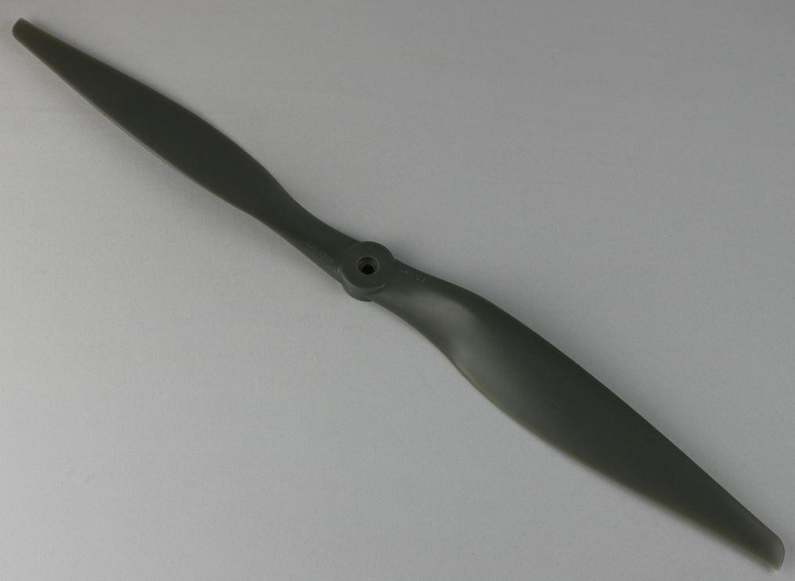
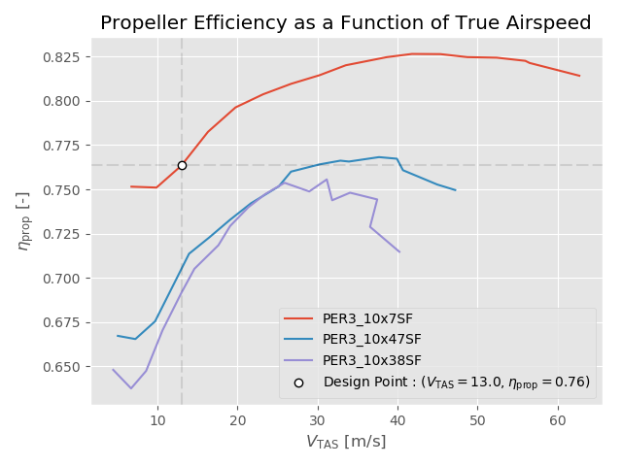
Propeller (propeller.py) (prop_data_parser.py)
The propeller is chosen based on the recommendation from the chosen motor.
This recommendation represents a range of propeller diameters.
Over 400 propeller data files are read and parsed from our database and their maximum efficiencies are found as a function of flight speed.
An input design speed is then used to select the best propeller.
The propeller data is found from the following link: https://www.apcprop.com/technical-information/performance-data/

Slide 24
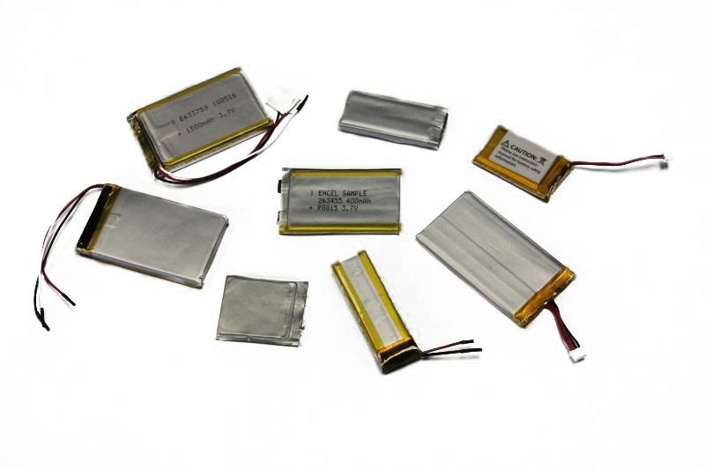





Lithium Polymer Battery (battery.py)
LiPo batteries are chosen due to better safety (less volatility)
The battery is sized from the power required by the aircraft in cruising flight, the flight controller, the speed controller(s), the payload and motor.
The power required by the aircraft in flight is found with the Equations below. The propulsive efficiency is included.
This method is from the AE1110-I Intro to Aerospace Engineering Flight Mechanics Lecture 2 slides.
The zero lift drag coefficient is assumed to be 0.02
Notes:
Specific Energy Density found from: http://www.hardingenergy.com/lithium/
This is also the citation to the image

Slide 25
Fuselage (fcone.py), (fframe.py), (mframe.py), (fuselage.py)
The fuselage is sized from the internal components previously defined and these frames are constructed based on the typical oval section found on commercial drones (next slide)
There are frames constructed which fit to bboxes of the internal components.
In order to approximate an aerodynamic shape, the bottom of the fuselage is forced flat, and the top is allowed to mold to the internal shapes. This creates an airfoil like fuselage, enhancing the lifting capability of the drone.
A forward-chaining inference procedure is used in a for loop that traverses the fuselage from nose to tail and fires all fireable rules sequentially. This procedure is preferred since multiple possibilities at each frame location exist (nose, container, motor, or tail) along with the same number of possibilities existing at the nearest neighbor. Finally, the start and end boundary conditions reject the creation of a nose or tail-cone before the fuselage is built, since both of these classes require tangency conditions at the start and end of the fuselage.
These frames are then lofted together with a shell.

Slide 26
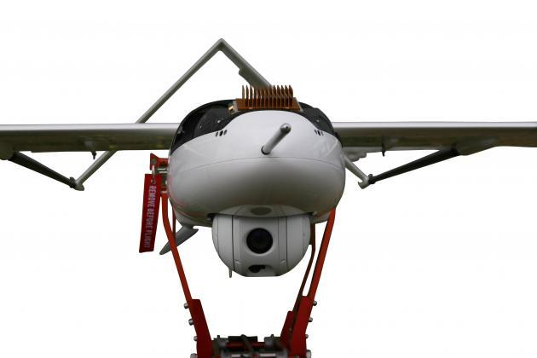
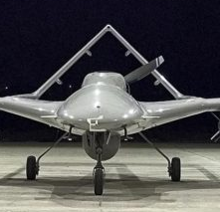
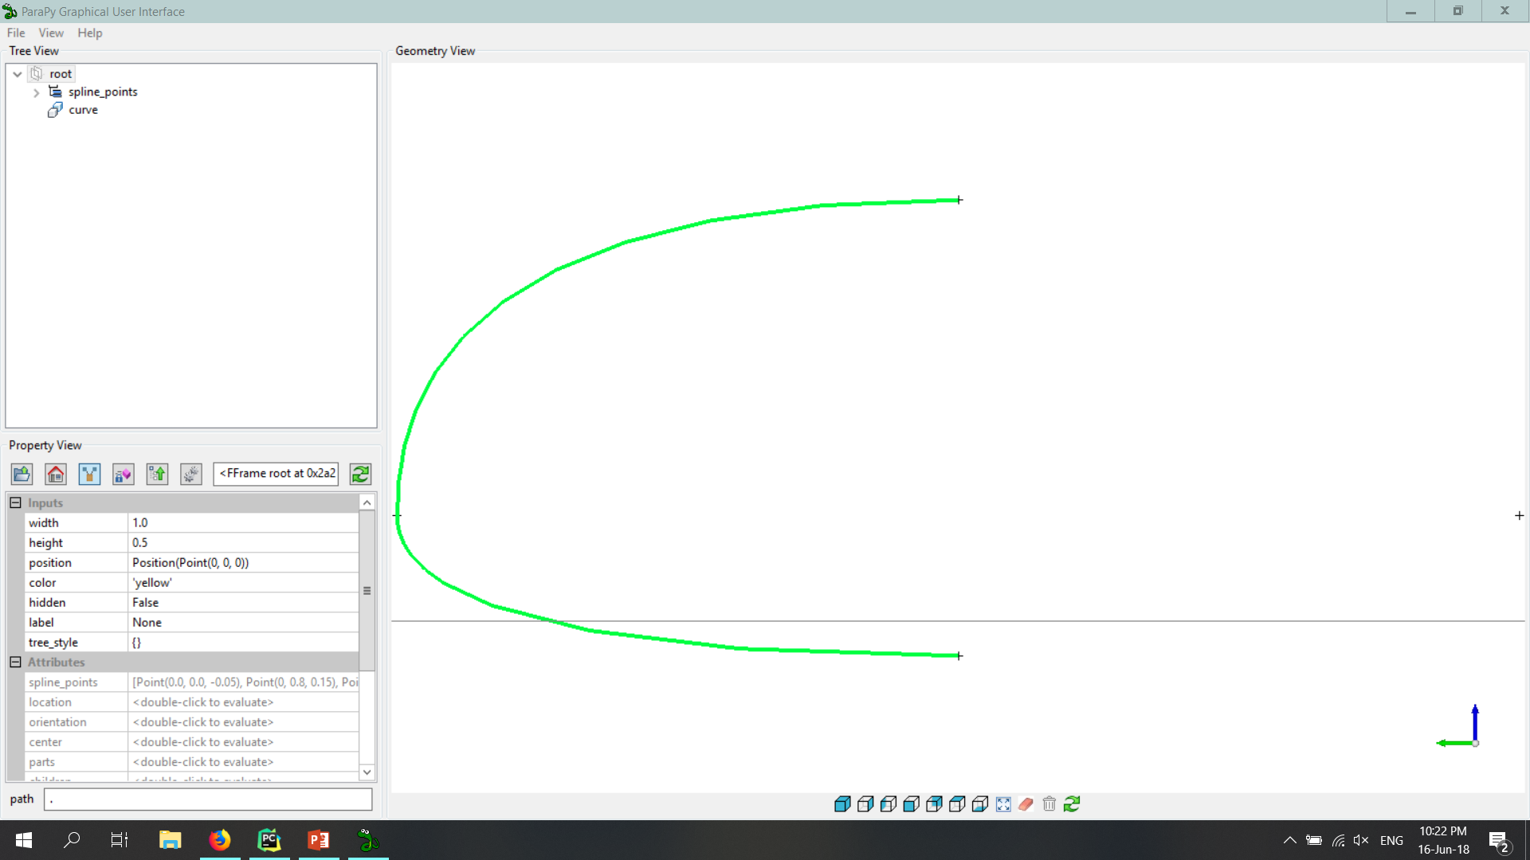
Typical Fuselage Section
Notes:
Left Image: Penguin-C http://www.uavfactory.com/product/74
Right Image: Bayrakter TB2 https://thedefensepost.com/2018/03/14/qatar-turkey-drones-armored-vehicles-ships-deals/

Slide 27

Performance (performance.py)
The performance of the final UAV is to be derived and compared to the mission requirements.
The new stall speed is calculated from the updated MTOW from the component weight estimation.
The CD0 is found with the method from Raymer shown in the Equation below. C_fe is assumed to be 0.0055 (light single engine aircraft):
http://www.fzt.haw-hamburg.de/pers/Scholz/HOOU/AircraftDesign_13_Drag.pdf
This CD0 is then used in the same power equations from the battery slide and the power required is plotted vs. airspeed. The actual speeds for maximum range and endurance are derived from this plot and the range and endurance are recalculated.
If these speeds are too close to the stall speed, they are increased by a safety factor.

Slide 28
